Slide 1
Logical Model

Slide 2
What is Logical Model?
A logical model describes the data in as much detail as possible, without regard to how they will be physical implemented in the database. Features of a logical data model include:
Includes all entities and relationships among them.
All attributes for each entity are specified.
The primary key for each entity is specified.
Foreign keys (keys identifying the relationship between different entities) are specified.
Normalization occurs at this level.
Designed and Developed by an Data Modeler, and intended for Database Developers and DBA
Designed and developed to be independent of DBMS, data storage locations or technologies

Slide 3
Steps for Logical Model
Specify primary keys for all entities.
Find the relationships between different entities.
Find all attributes for each entity.
Resolve many-to-many relationships.
Do Normalization.

Slide 4
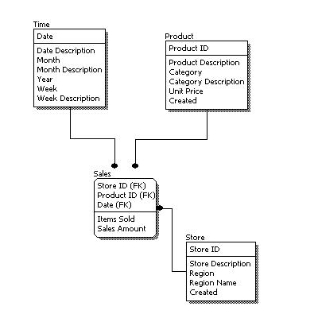

Slide 5
Conceptual Vs. Logical Model
In a logical model, primary keys are present, whereas in a conceptual model, no primary key is present.
In a logical model, all attributes are specified within an entity. No attributes are specified in a conceptual model.
Relationships between entities are specified using primary keys and foreign keys in a logical model. In a conceptual model, the relationships are simply stated, not specified, so we simply know that two entities are related, but we do not specify what attributes are used for this relationship.

